Slide 1
Chinook Database
Analyzing Digital Music Store Database
Nolawi Adugna
January 2023

Slide 2
Who is the top-selling Artist each year?
The British heavy metal band Iron Maiden sold the most albums between 2009 and 2013, with the exception of 2011, when the band U2 had higher sales.

Slide 3
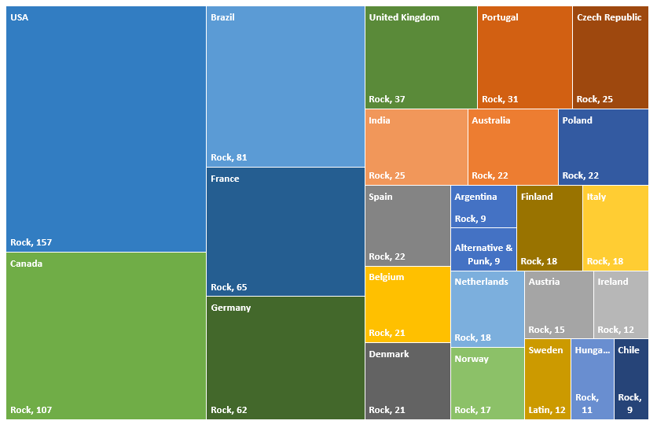
What is the most popular genre by Country?
The popularity of music genres varies by country, with some genres being more frequently purchased than others. A breakdown of the total number of tracks sold for each genre in each country shows that rock music was the most popular in many countries, particularly in the USA and Canada. This genre generated the largest sales in these countries.

Slide 4
What is the Average duration of tracks, measured in minutes, for each genre?
It is apparent that the average length of songs varies by genre. The genres of metal and electronic/ dance music have the longest average playtime, with an average of 5.16 and 5.06 minutes, respectively. On the other hand, opera and rock and roll have the shortest average play time, at 2.91 and 2.24 minutes, respectively.

Slide 5
Who is the best customer by total purchase from each country?
This graph illustrates the top ten customers who have made the most purchases of music. Helena from the Czech Republic is the top customer in terms of purchases, followed by Richard from the USA.

